Slide 1
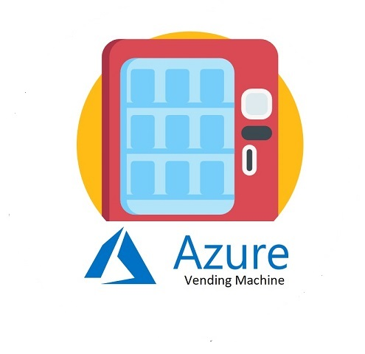
Azure Vending Machine V2.0
Top Phongsakorn Nakornratanachai

Slide 2
What’s your hack project story?
Where did the idea come from? (very briefly)
>> I worked with Client on Innovation Bubble, and they have the challenge around how Business can get resource without requesting IT team every time.
Why do you care about this idea/area?
>> It can be a tool that help non-IT people to get resource faster
How does this relate to your day jobs, if at all?
>> I try to build this application using variety of our Azure/365 products such as PowerApps/Power Automate/API Management/Azure Logic App/ARM template so it can be used as show case to customer as well.
Notes:
Note: Don’t spend too much time on the “set-up” or problem statement. Viewers usually pick that up quickly, and they want to get to hearing about your project/solution.

Slide 3
Primary customer
Any Non-IT users in any organizations

Slide 4
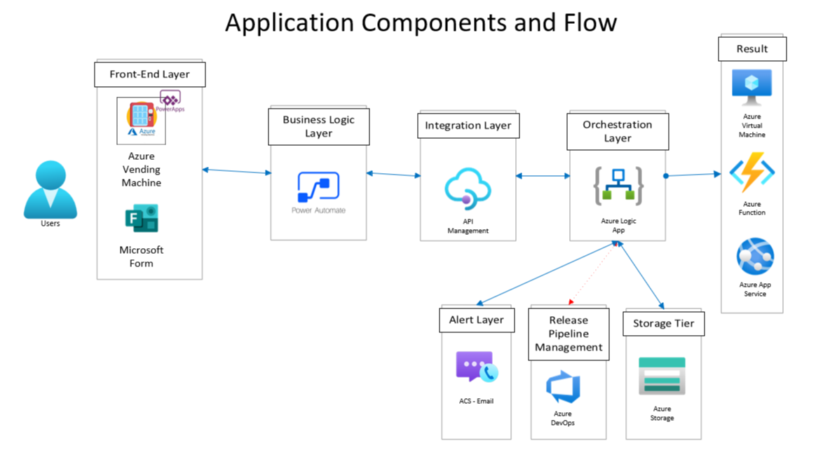
How does it work?

Slide 5
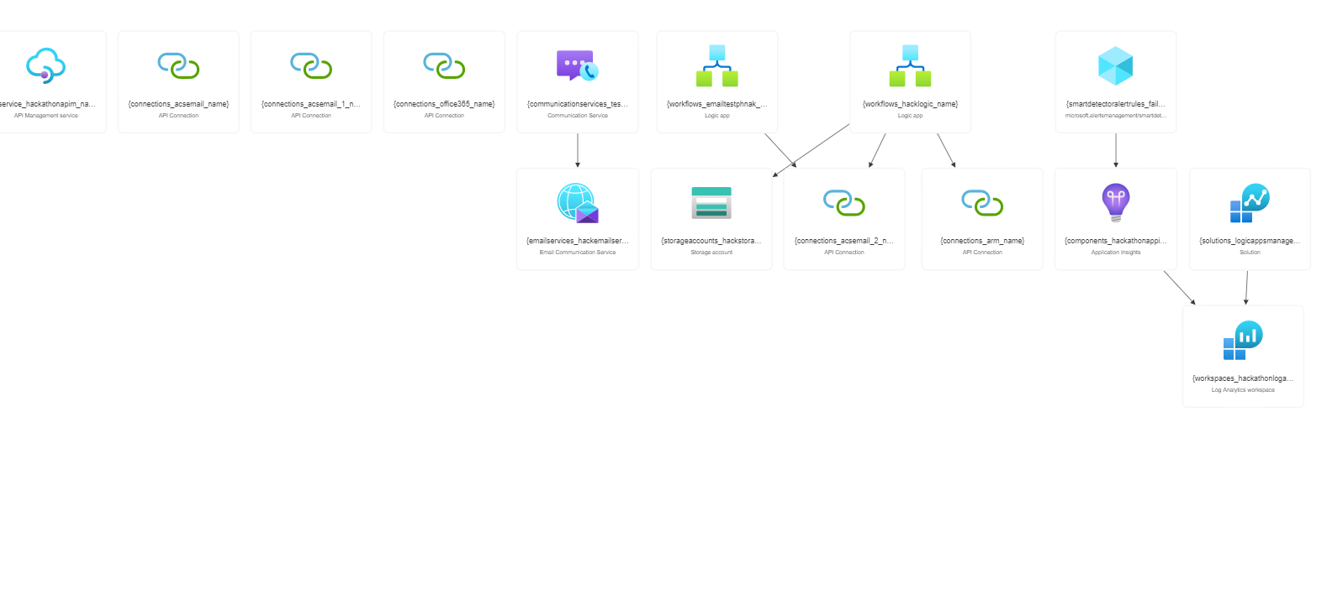

Slide 6
DEMO
Prototype
Application

Slide 7
Impact for the Customer
Why is this solution different and compelling for the customer?
>> Business can get their resource faster through automated process and without the wait time for IT team to action on it

Slide 8
Impact for Microsoft
Why are you participating in a Hackathon?
>> Learning new skills and new products that have been out in the past 1 year
How you envision the impact of your hack
>> I hope that with my prototype here I can leverage this for my customers in my patch

Slide 9
Thank you!

